Slide 1
MCEN90041 Advanced Dynamics
Group 26:
JACK HOPPER
LYLE TALBOT
SCOTT LEE
SRINATH KADAMBI

Slide 2
OUTLINE
Introduction to dynamical system
Coordinate system, DOF
Kinetic energy of our system
Potential energy of our system
Lagrangian formulation
Generalized forces
Equations of motion
Collision Modelling
Simulation and animation

Slide 3
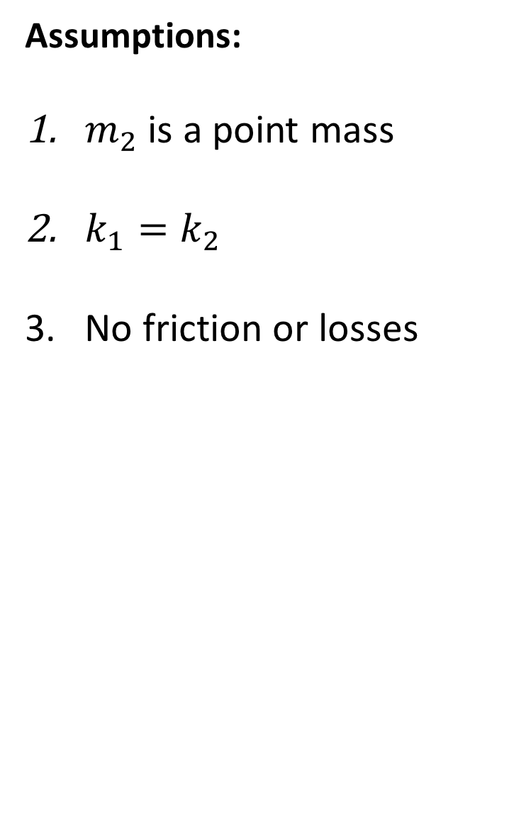
THE SYSTEM
Assumptions:
$m_{2}$ is a point mass
$k_{1}=k_{2}$
No friction or losses

Slide 4
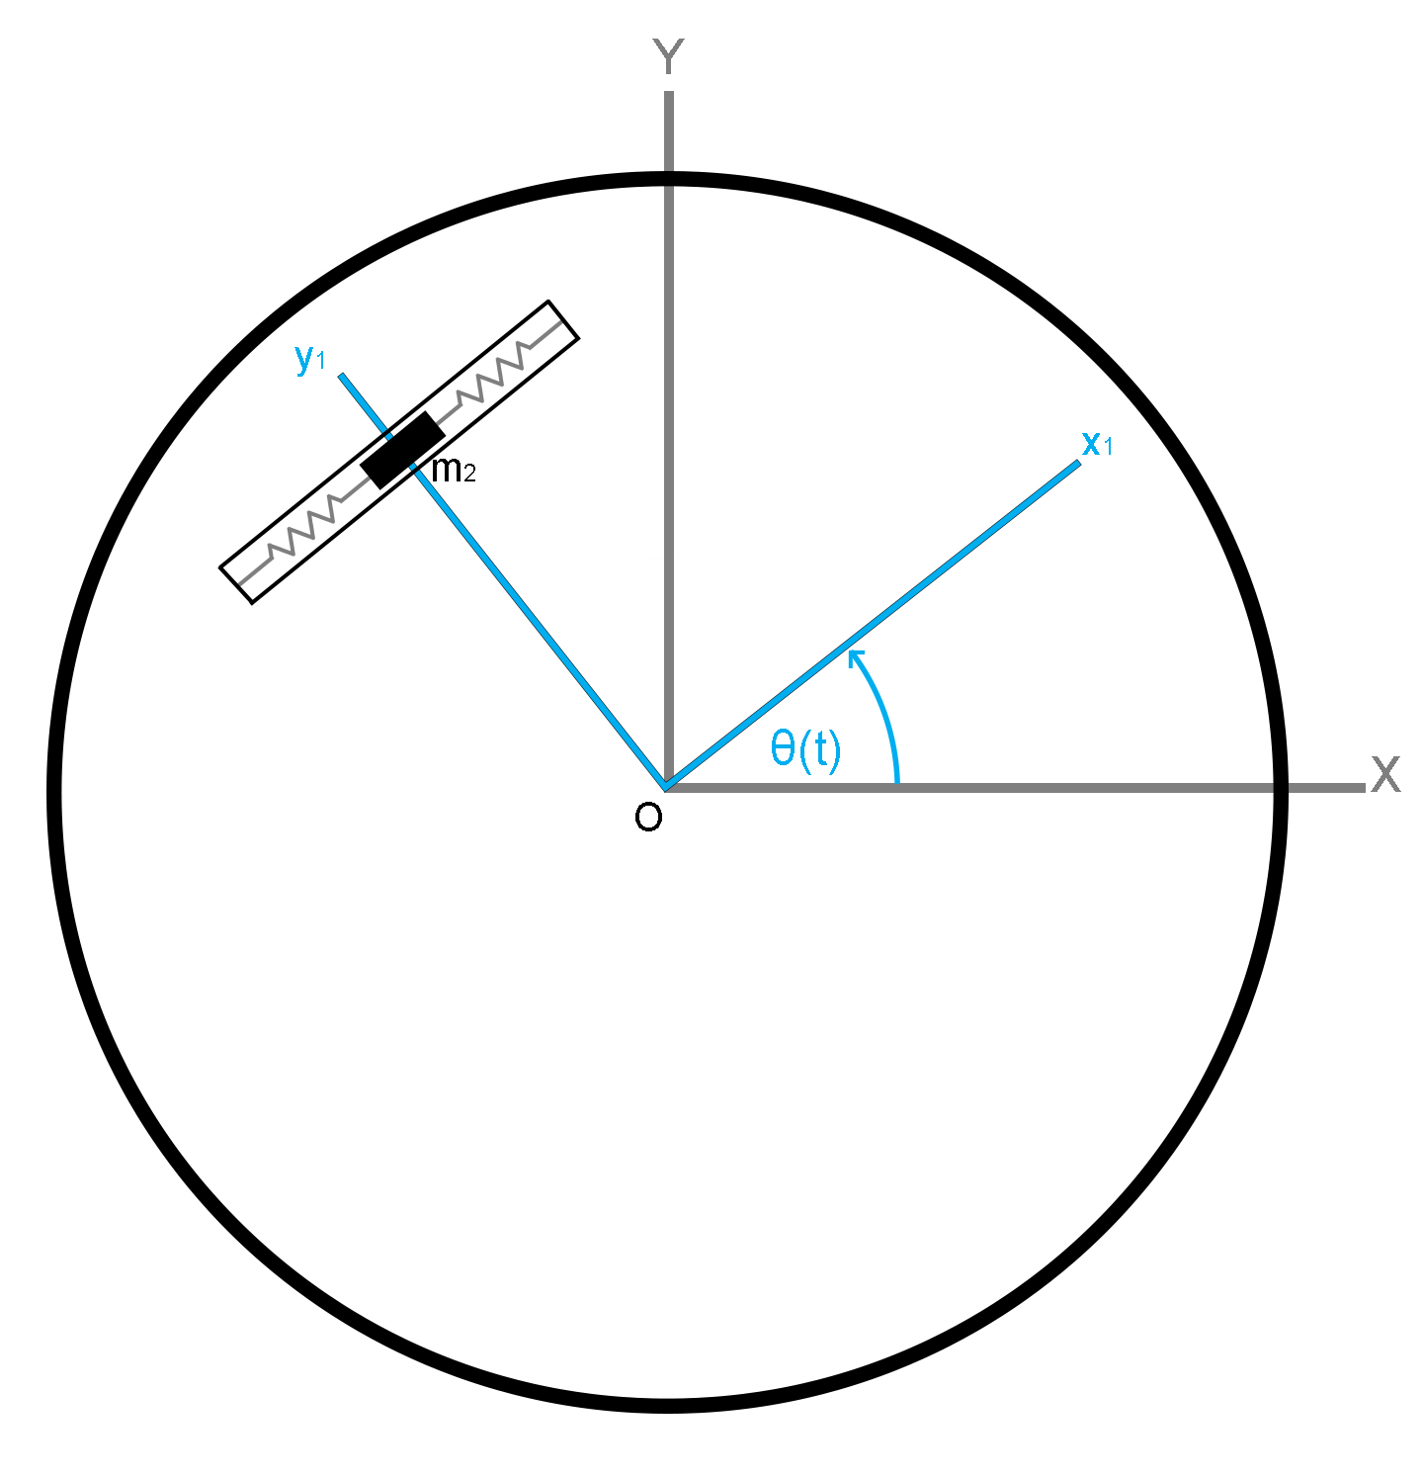
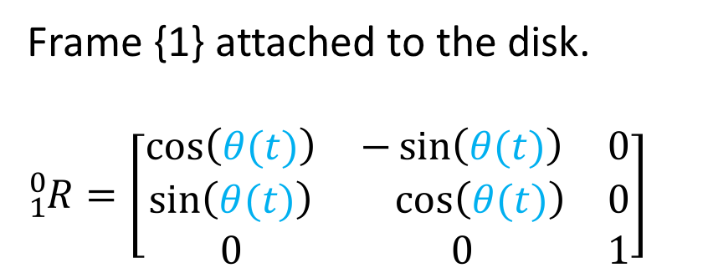
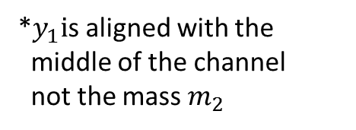
COORDIANTES FRAMES
Frame {1} attached to the disk.
$${}_{1}^{0}R=\left[\begin{matrix}\cos\left(θ(t)\right) & −\sin\left(θ(t)\right) & 0 \\ \sin\left(θ(t)\right) & \cos\left(θ(t)\right) & 0 \\ 0 & 0 & 1\end{matrix}\right]$$
*$y_{1}i$s aligned with the
middle of the channel
not the mass $m_{2}$

Slide 5
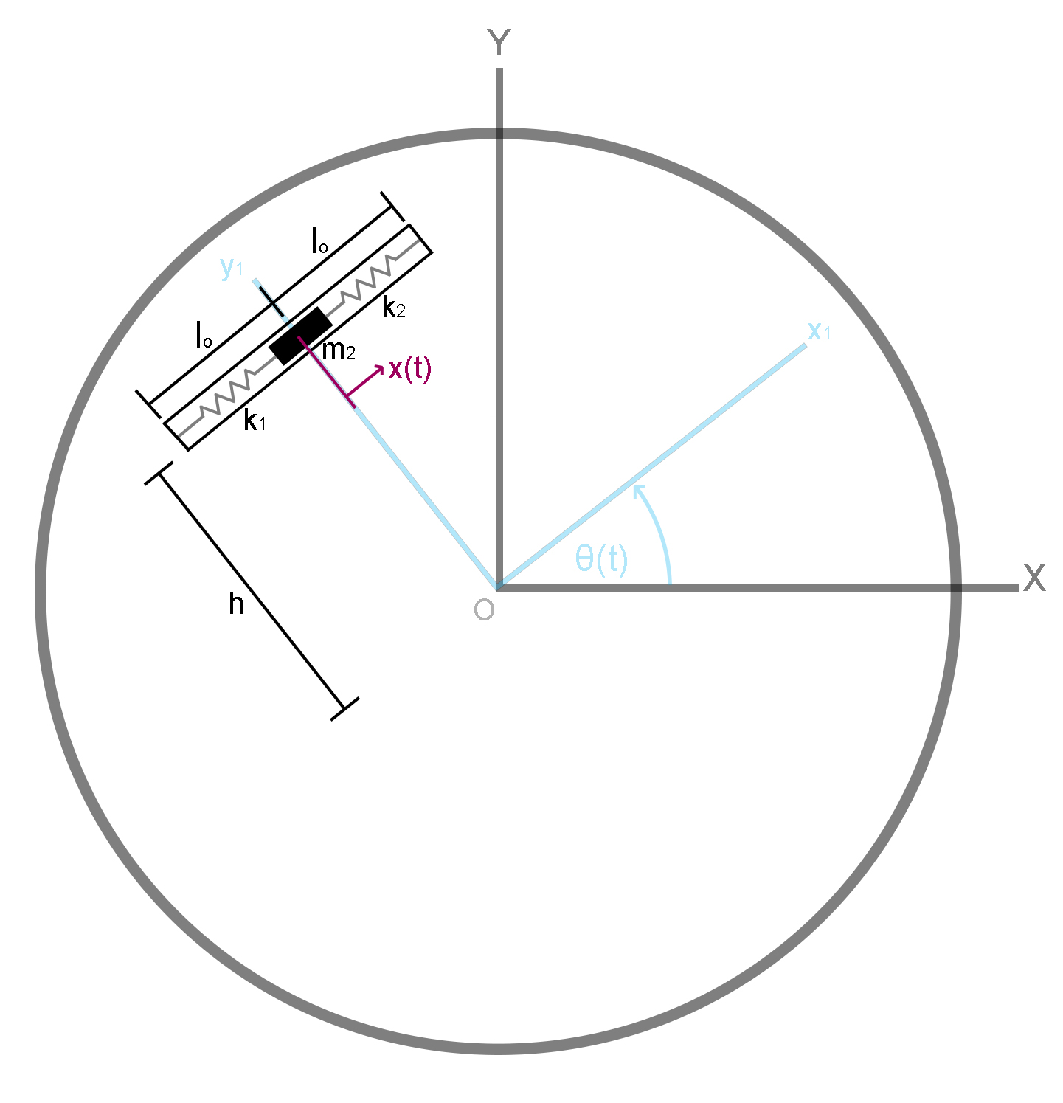
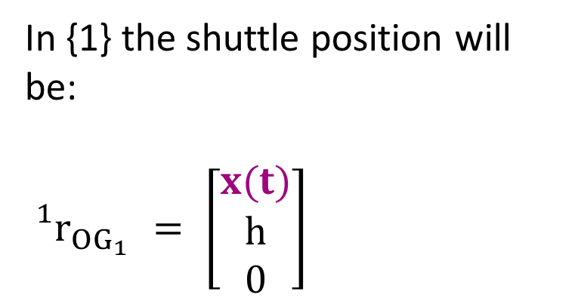
SHUTTLE POSSITION
In {1} the shuttle position will be:
${}_{}^{1}{r_{OG_{1}}}$ $= \left[\begin{matrix}x(t) \\ h \\ 0\end{matrix}\right]$

Slide 6
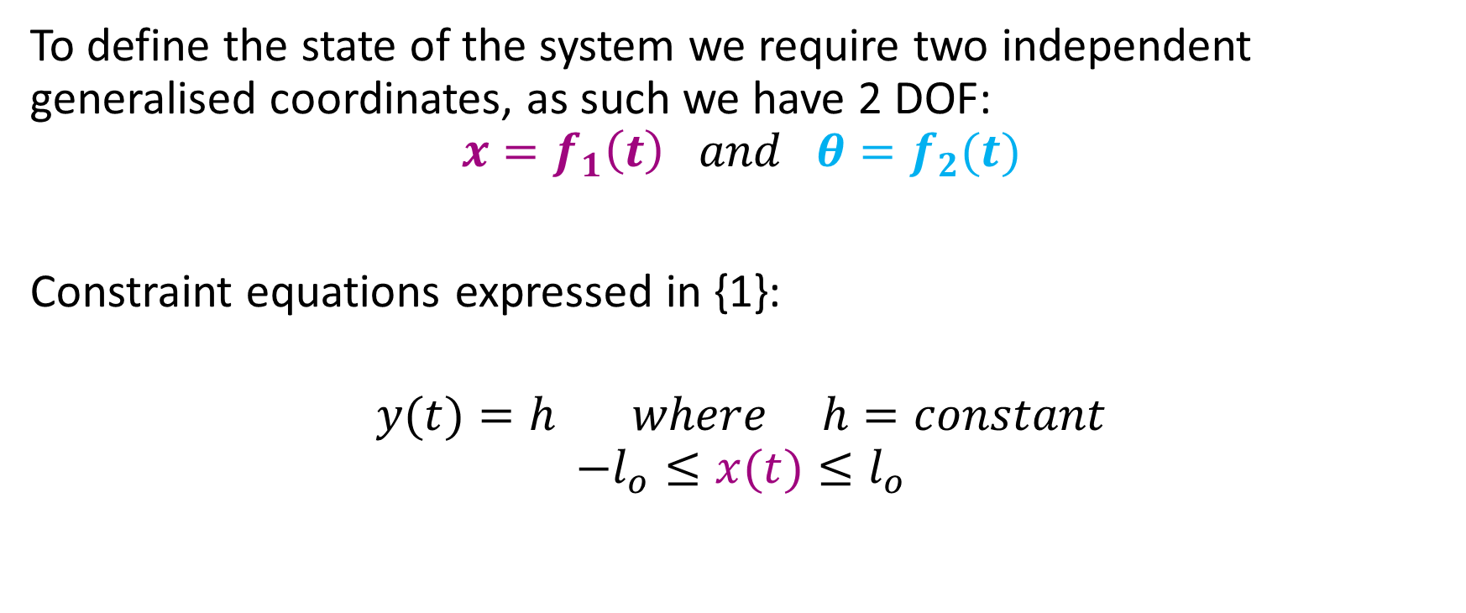
CONSTRAINTS AND GENERALISED COORDINATES
To define the state of the system we require two independent generalised coordinates, as such we have 2 DOF:
$$x=f_{1}\left(t\right) and θ=f_{2}(t)$$
Constraint equations expressed in {1}:
$$y(t)=h where h=constant$$
$$−l_{o}≤x(t)≤l_{o}$$
m

Slide 7
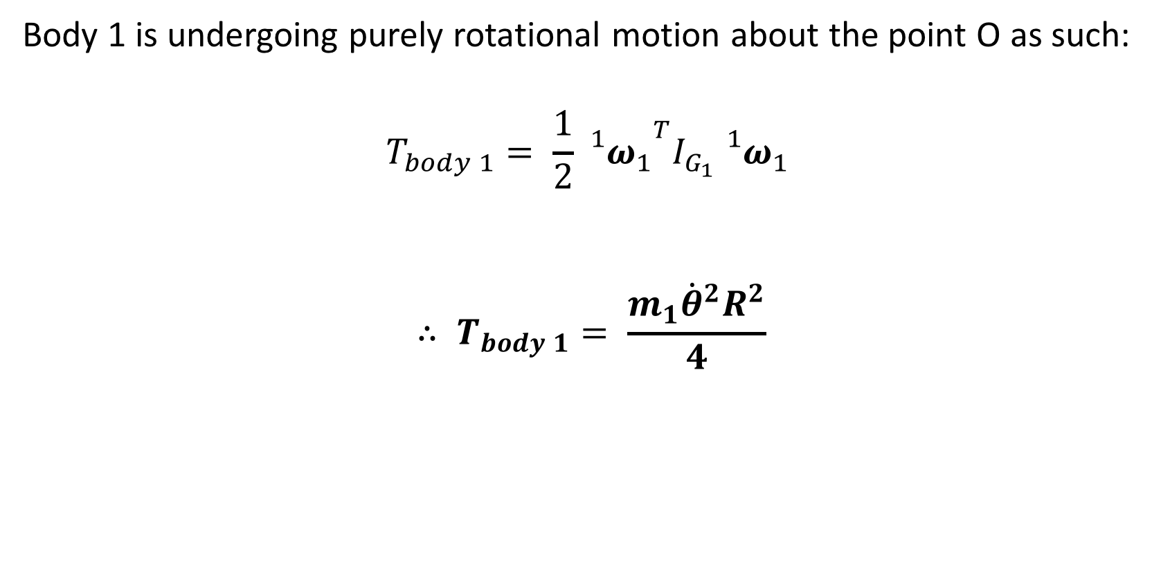
KINETIC ENERGY (Disk)
Body 1 is undergoing purely rotational motion about the point O as such:
$$T_{body 1}= \frac{1}{2}{{{}_{}^{1}ω}_{1}}^{T}I_{G_{1}}{{}_{}^{1}ω}_{1 }$$
$$∴ T_{body 1}= \frac{m_{1}{\dot{θ}}^{2}R^{2}}{4}$$

Slide 8
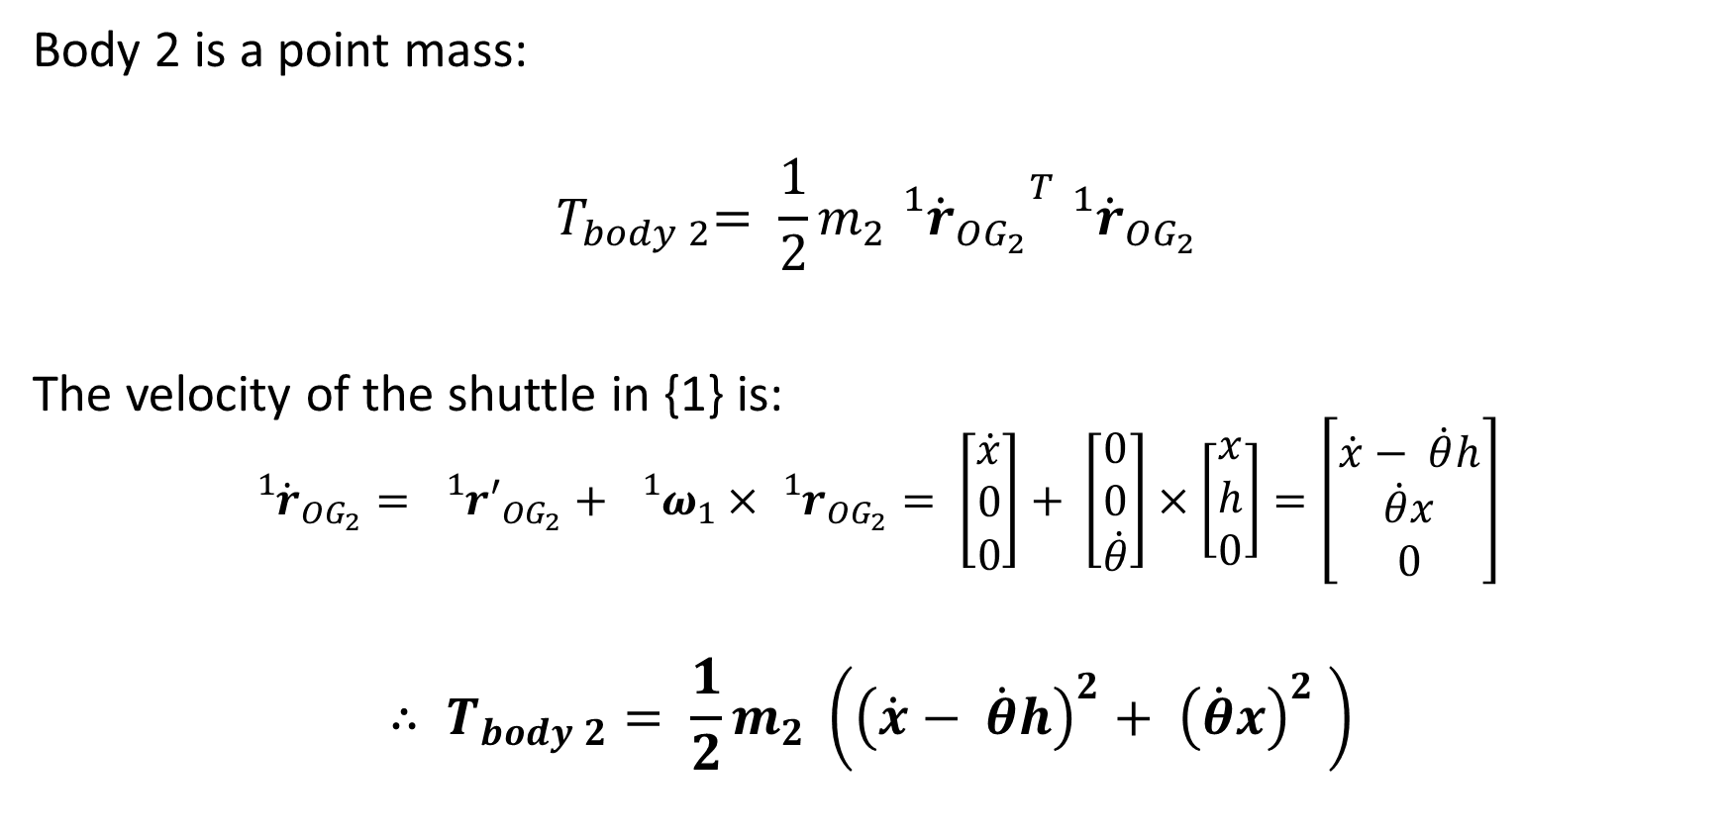
KINETIC ENERGY (shuttle)
Body 2 is a point mass:
$${ T}_{body 2}= \frac{1}{2}m_{2}{{{}_{}^{1}{\dot{r}}}_{OG_{2}}}^{T}{{}_{}^{1}{\dot{r}}}_{OG_{2}}$$
The velocity of the shuttle in {1} is:
$${{}_{}^{1}{\dot{r}}}_{OG_{2}}= {{}_{}^{1}r′}_{OG_{2}}+ {{}_{}^{1}ω}_{1}×{{}_{}^{1}r}_{OG_{2}}= \left[\begin{matrix}\dot{x} \\ 0 \\ 0\end{matrix}\right]+ \left[\begin{matrix}0 \\ 0 \\ \dot{θ}\end{matrix}\right]×\left[\begin{matrix}x \\ h \\ 0\end{matrix}\right]=\left[\begin{matrix}\dot{x}− \dot{θ}h \\ \dot{θ}x \\ 0\end{matrix}\right]$$
$$∴ T_{body 2}= \frac{1}{2}m_{2} \left({\left(\dot{x}− \dot{θ}h\right)}^{2}+ {\left(\dot{θ}x\right)}^{2} \right)$$

Slide 9
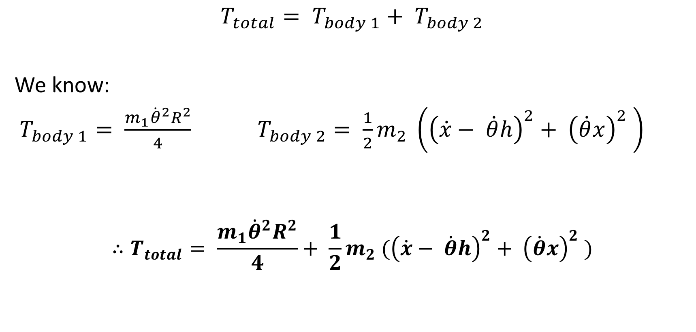
TOTAL KINETIC ENERGY
$$T_{total}= T_{body 1}+ T_{body 2}$$
We know:
$T_{body 1}= \frac{m_{1}{\dot{θ}}^{2}R^{2}}{4}$ $T_{body 2}= \frac{1}{2}m_{2} \left({\left(\dot{x}− \dot{θ}h\right)}^{2}+ {\left(\dot{θ}x\right)}^{2} \right)$
$$∴T_{total}= \frac{m_{1}{\dot{θ}}^{2}R^{2}}{4}+ \frac{1}{2}m_{2} ({\left(\dot{x}− \dot{θ}h\right)}^{2}+ {\left(\dot{θ}x\right)}^{2} )$$

Slide 10
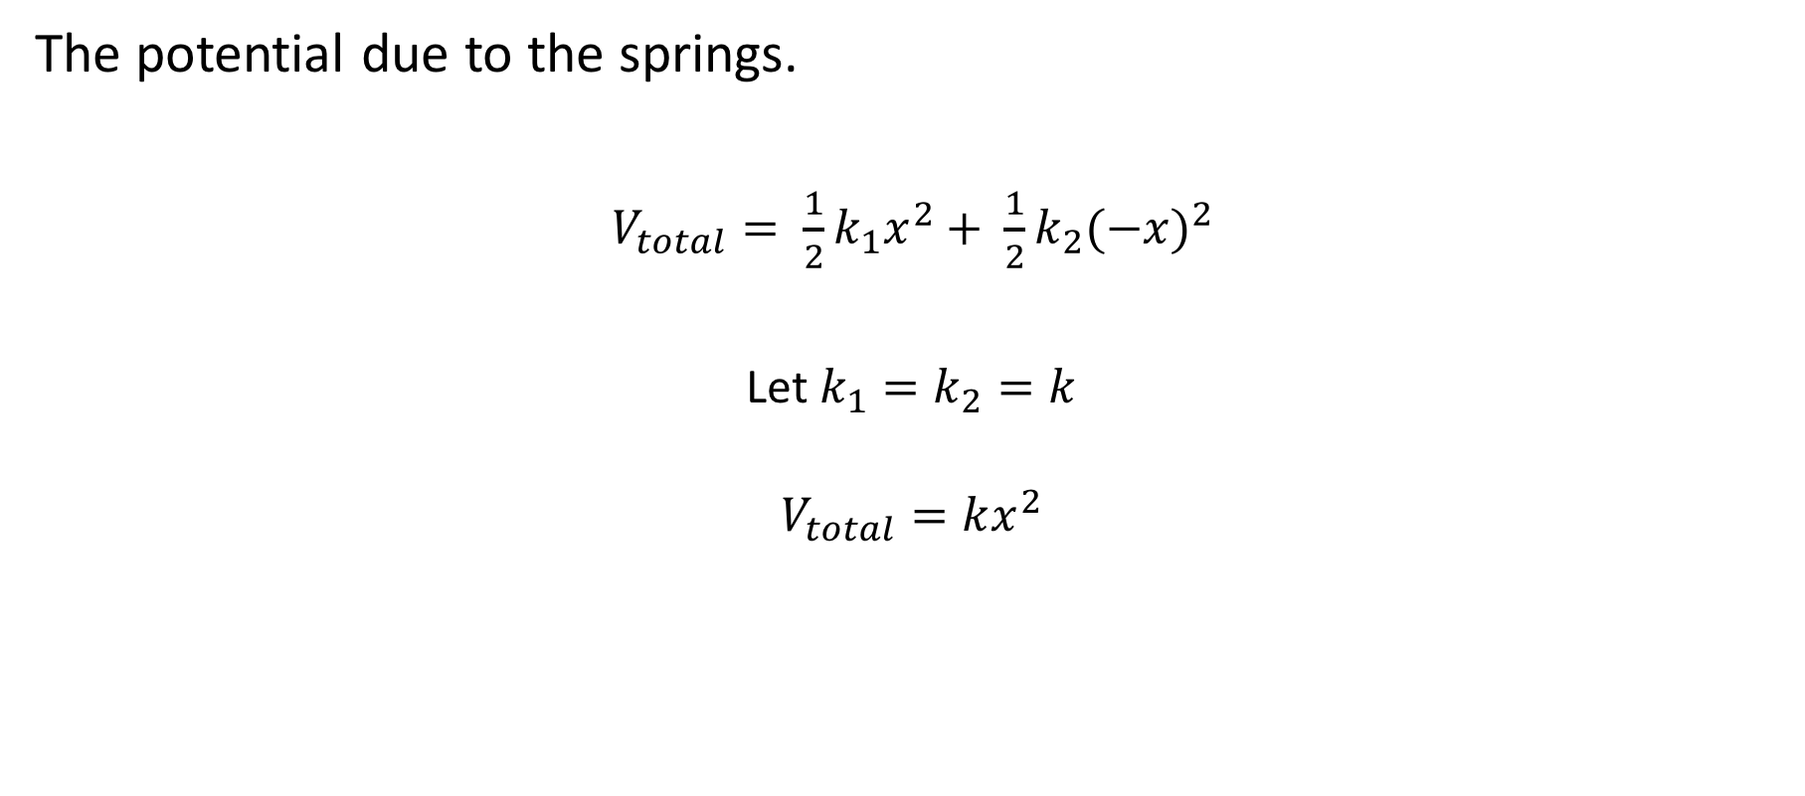
POTENTIAL ENERGY
The potential due to the springs.
$V_{total}= \frac{1}{2}k_{1}x^{2}+ \frac{1}{2}k_{2}{(−x)}^{2}$
Let$k_{1}=k_{2}=k$
$$V_{total}=kx^{2}$$

Slide 11
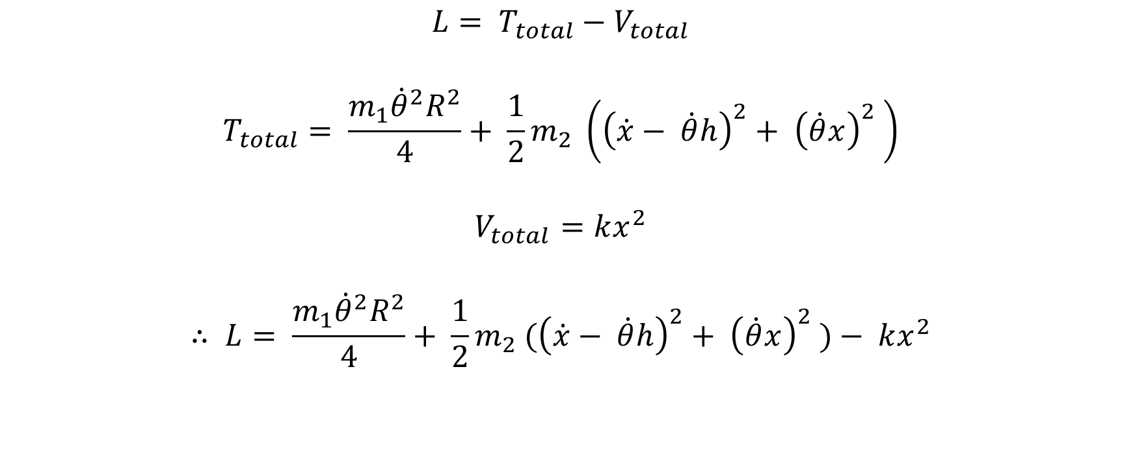
LAGRANGIAN
$$L= T_{total}−V_{total}$$
$$T_{total}= \frac{m_{1}{\dot{θ}}^{2}R^{2}}{4}+ \frac{1}{2}m_{2} \left({\left(\dot{x}− \dot{θ}h\right)}^{2}+ {\left(\dot{θ}x\right)}^{2} \right)$$
$$V_{total}=kx^{2}$$
$$∴ L= \frac{m_{1}{\dot{θ}}^{2}R^{2}}{4}+ \frac{1}{2}m_{2} ({\left(\dot{x}− \dot{θ}h\right)}^{2}+ {\left(\dot{θ}x\right)}^{2} )− kx^{2}$$

Slide 12
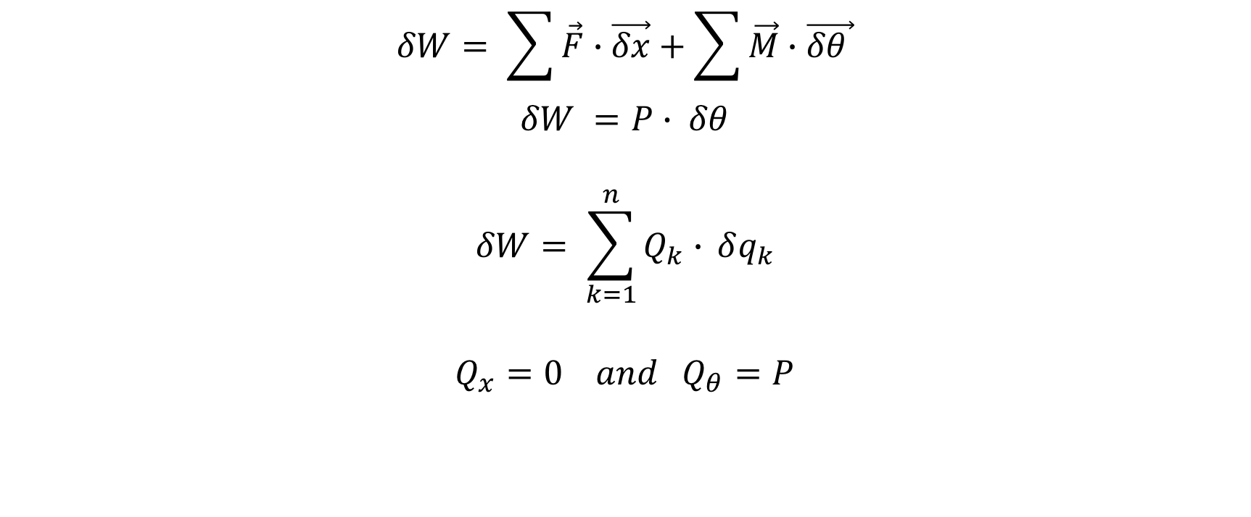
GENERALIZED FORCES
$$δW= \sum{\vec{F}}∙\vec{δx}+\sum{\vec{M}}∙\vec{δθ }$$
$$δW =P∙ δθ$$
$$δW= \sum_{k=1}^{n}{Q_{k}∙} δq_{k}$$
$$Q_{x}=0 and Q_{θ}=P$$

Slide 13
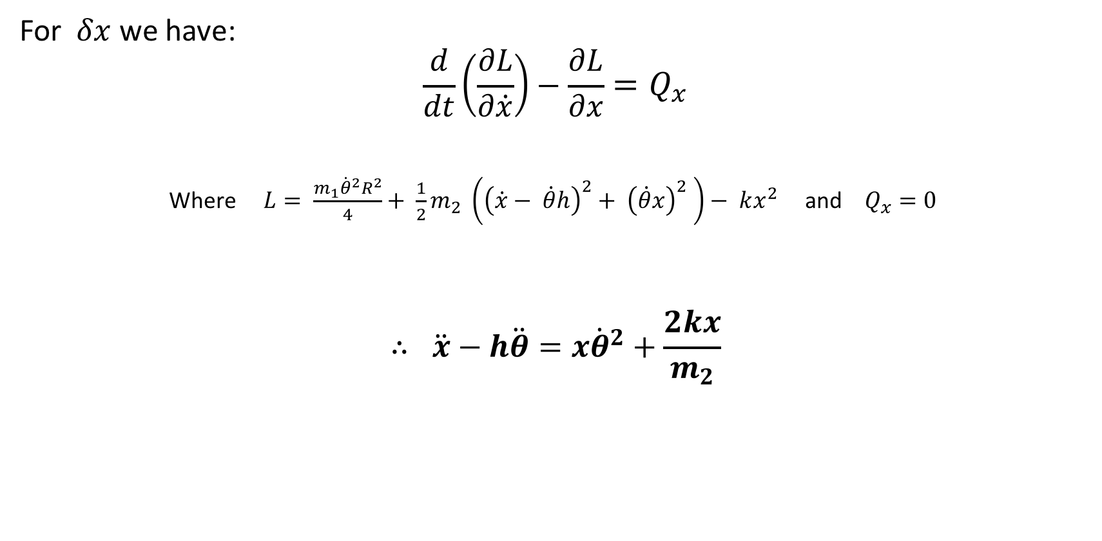
EQUATIONS OF MOTION
For $δx$ we have:
$$\frac{d}{dt}\left(\frac{∂L}{∂\dot{x}}\right)−\frac{∂L}{∂x}=Q_{x}$$
Where $L= \frac{m_{1}{\dot{θ}}^{2}R^{2}}{4}+ \frac{1}{2}m_{2} \left({\left(\dot{x}− \dot{θ}h\right)}^{2}+ {\left(\dot{θ}x\right)}^{2} \right)− kx^{2}$and $Q_{x}=0$
$$∴ \ddot{x}−h\ddot{θ}=x{\dot{θ}}^{2}+\frac{2kx}{m_{2}}$$

Slide 14
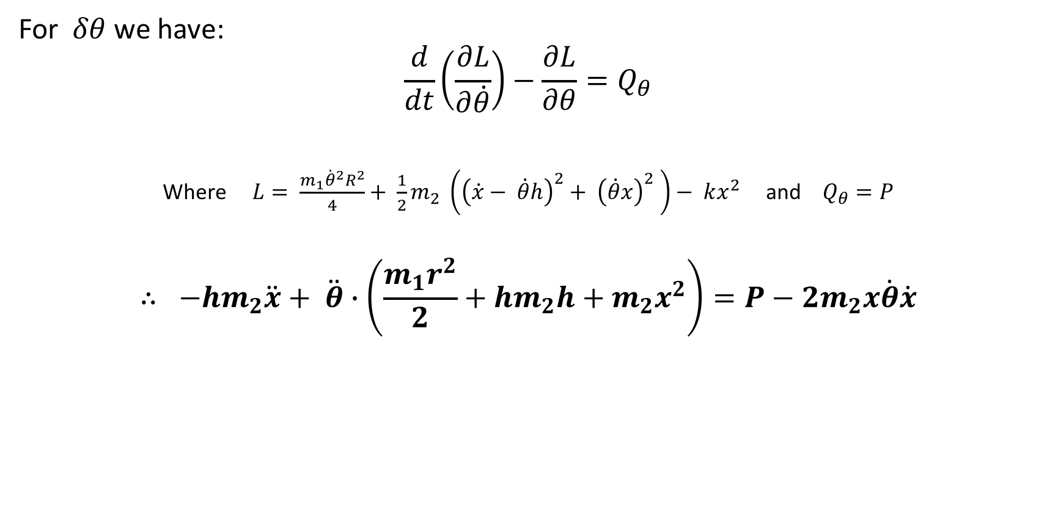
EQUATIONS OF MOTION
For $δθ$ we have:
$$\frac{d}{dt}\left(\frac{∂L}{∂\dot{θ}}\right)−\frac{∂L}{∂θ}=Q_{θ}$$
Where $L= \frac{m_{1}{\dot{θ}}^{2}R^{2}}{4}+ \frac{1}{2}m_{2} \left({\left(\dot{x}− \dot{θ}h\right)}^{2}+ {\left(\dot{θ}x\right)}^{2} \right)− kx^{2}$and $Q_{θ}=P$
$$∴ −hm_{2}\ddot{x}+ \ddot{θ}∙\left(\frac{m_{1}r^{2}}{2}+hm_{2}h+m_{2}x^{2}\right)=P−{2m}_{2}x\dot{θ}\dot{x}$$

Slide 15
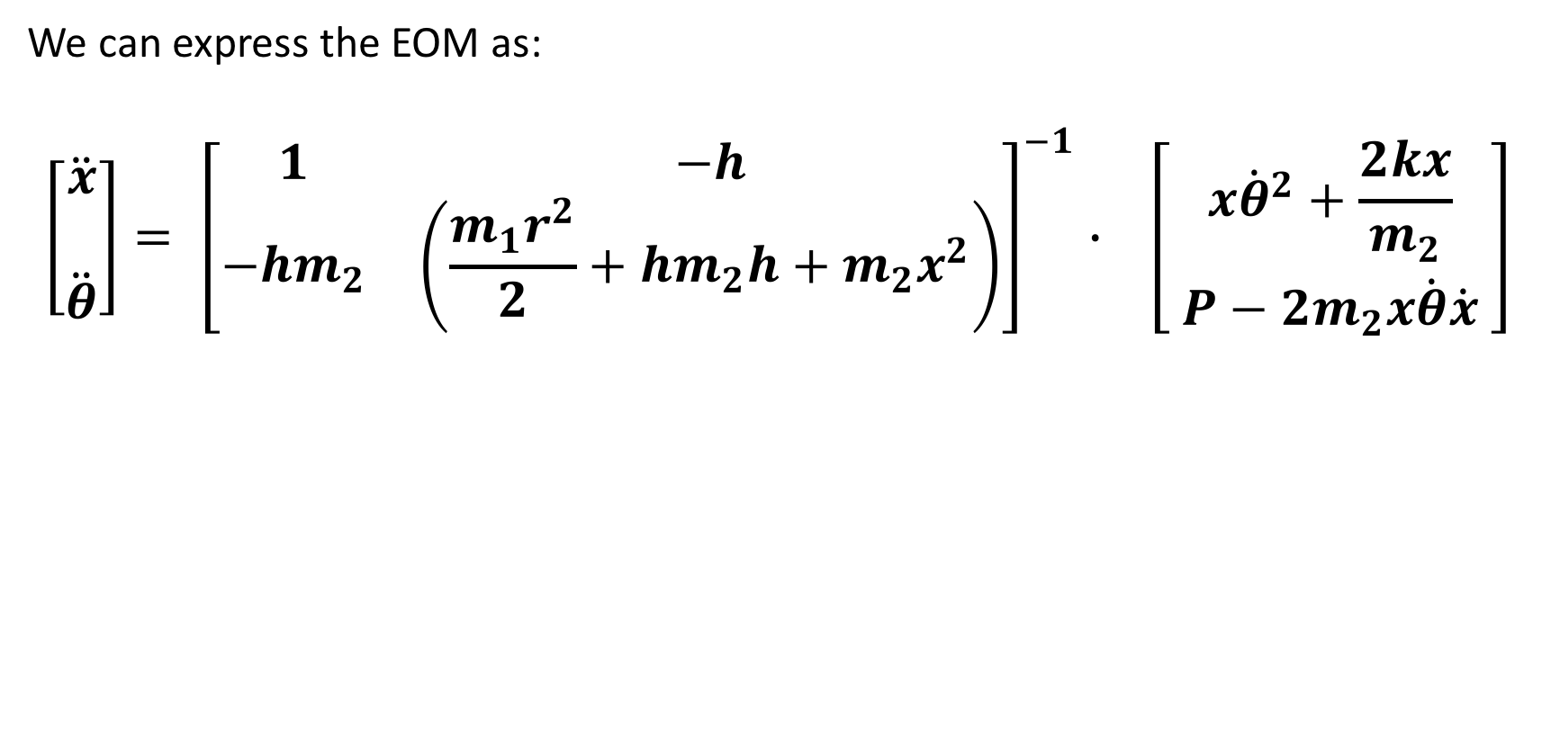
EQUATIONS OF MOTION
We can express the EOM as:
$$\left[\begin{matrix}\begin{aligned}\ddot{x} \\ \end{aligned} \\ \ddot{θ}\end{matrix}\right]= {\left[\begin{matrix}1 & −h \\ −hm_{2} & \left(\frac{m_{1}r^{2}}{2}+hm_{2}h+m_{2}x^{2}\right)\end{matrix}\right]}^{−1}∙ \left[\begin{matrix}x{\dot{θ}}^{2}+\frac{2kx}{m_{2}} \\ P−{2m}_{2}x\dot{θ}\dot{x} \end{matrix}\right]$$

Slide 16
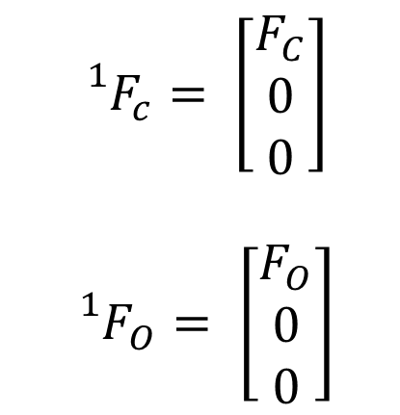
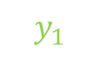


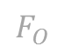

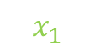
COLLISION MODELLING
$${{}_{}^{1}F}_{c}= \left[\begin{matrix}F_{C} \\ 0 \\ 0\end{matrix}\right]$$
$${{}_{}^{1}F}_{O}= \left[\begin{matrix}F_{O} \\ 0 \\ 0\end{matrix}\right]$$
Shuttle
$$F_{c}$$
$$F_{c}$$
$$y_{1}$$
$$O$$
$$F_{O}$$
$$x_{1}$$

Slide 17
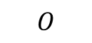
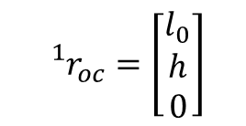
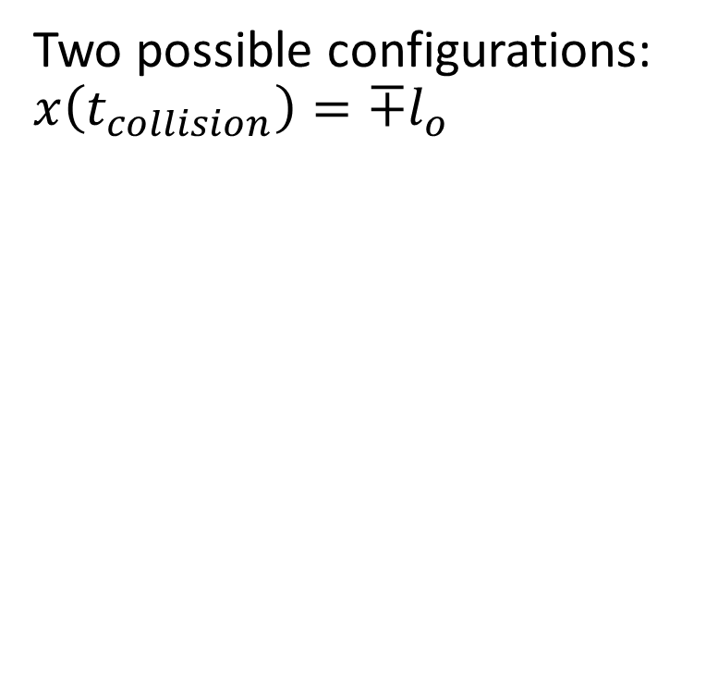
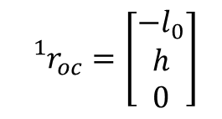
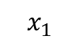
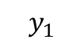
COLLISION MODELLING
Two possible configurations:
$$x\left(t_{collision}\right)={∓l}_{o}$$
Shuttle
Shuttle
Shuttle
$${}_{}^{1}{r_{oc}}=\left[\begin{matrix}−l_{0} \\ h \\ 0\end{matrix}\right]$$
$${}_{}^{1}{r_{oc}}=\left[\begin{matrix}l_{0} \\ h \\ 0\end{matrix}\right]$$
$$y_{1}$$
$$x_{1}$$
$$O$$

Slide 18
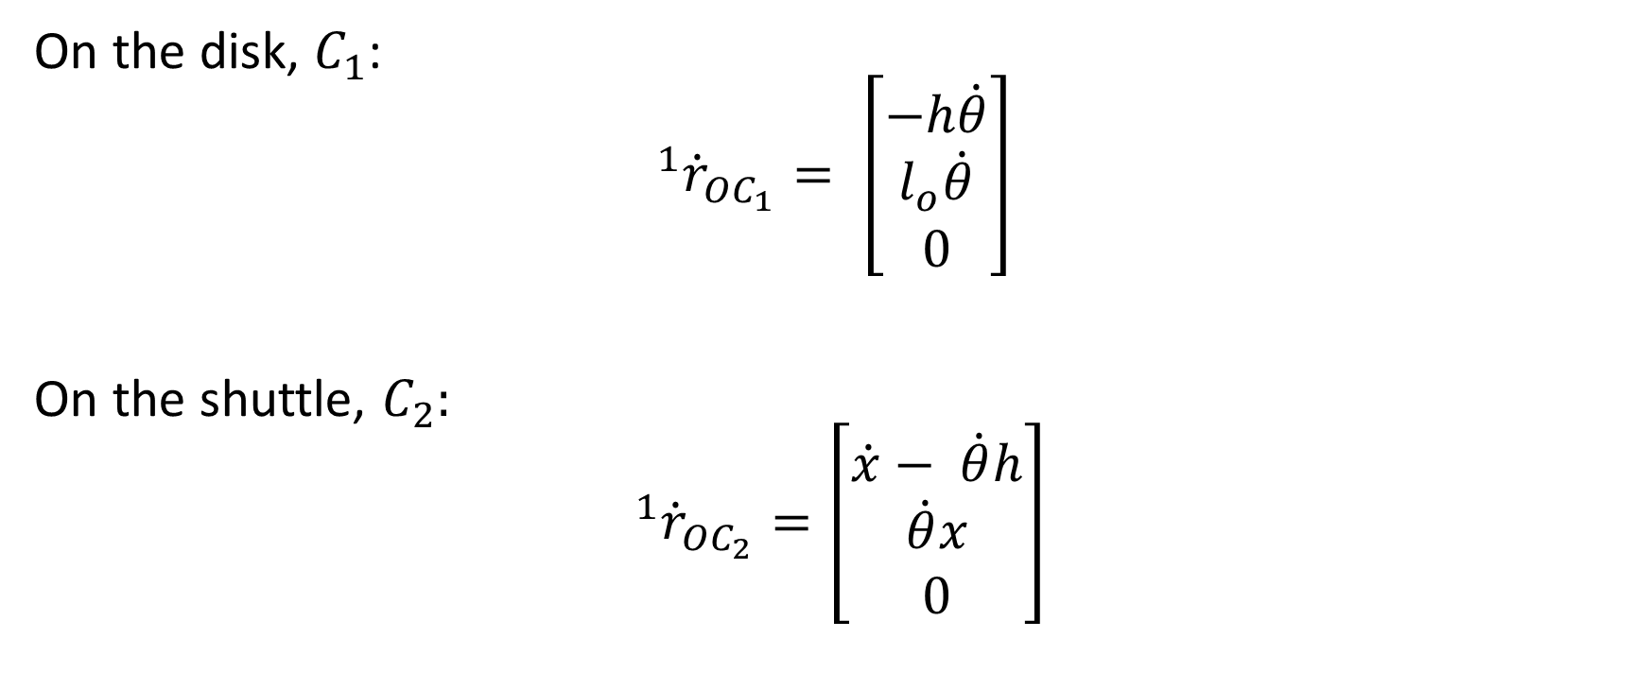
COLLISION MODELLING (VELOCITY VECTORS)
On the disk, $C_{1}$:
$$^{1}{\dot{r}}_{OC_{1}}= \left[\begin{matrix}−h\dot{θ} \\ l_{o}\dot{θ} \\ 0\end{matrix}\right]$$
On the shuttle, $C_{2}:$
$$^{1}{\dot{r}}_{OC_{2}}=\left[\begin{matrix}\dot{x}− \dot{θ}h \\ \dot{θ}x \\ 0\end{matrix}\right]$$

Slide 19
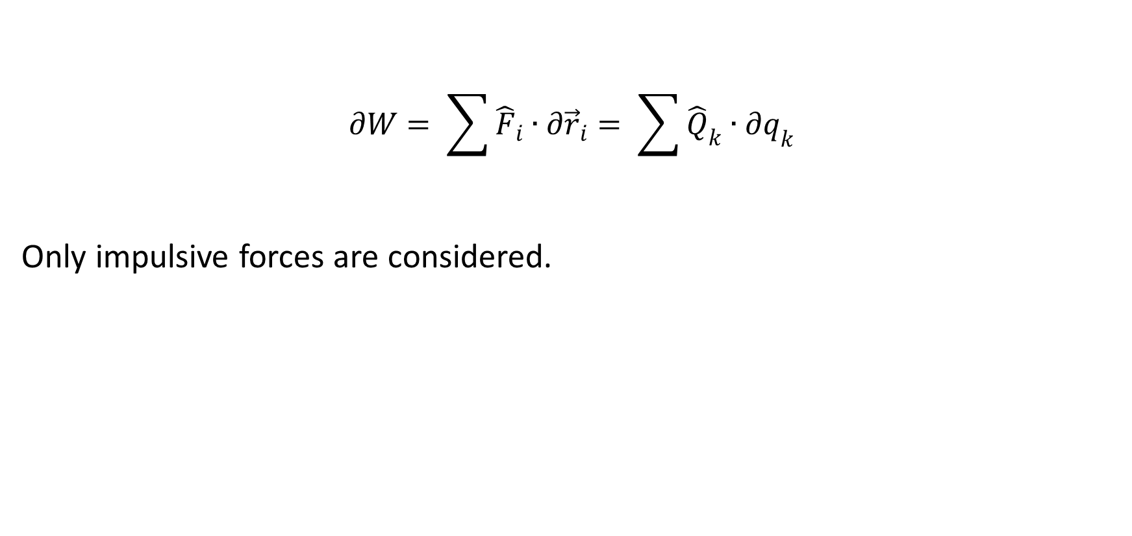
COLLISION MODELLING (VIRTUAL WORK DONE BY IMPULSE FORCES)
$$∂W= \sum{{\hat{F}}_{i}∙∂{\vec{r}}_{i}}= \sum{{\hat{Q}}_{k}∙∂q_{k}}$$
Only impulsive forces are considered.

Slide 20
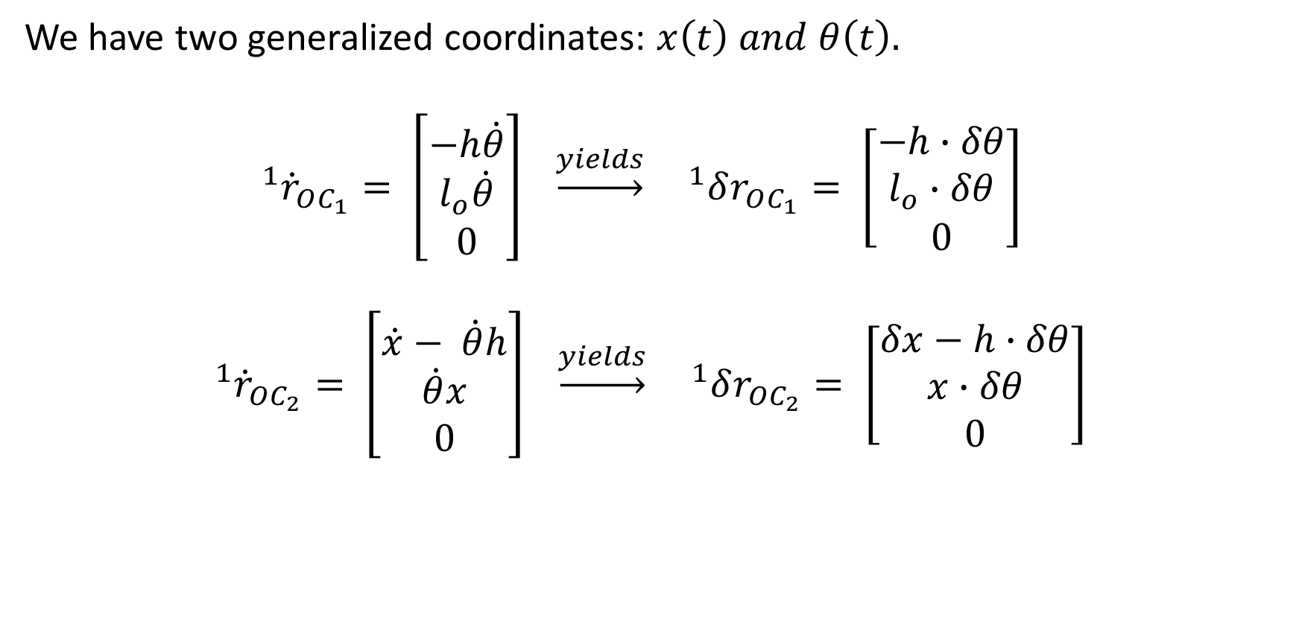
COLLISION MODELLING (VIRTUAL WORK DONE BY IMPULSE FORCES)
We have two generalized coordinates: $x\left(t\right) and θ\left(t\right).$
$$^{1}{\dot{r}}_{OC_{1}}= \left[\begin{matrix}−h\dot{θ} \\ l_{o}\dot{θ} \\ 0\end{matrix}\right] \underset{→}{yields} ^{1}δr_{OC_{1}}= \left[\begin{matrix}−h∙δθ \\ l_{o}∙δθ \\ 0\end{matrix}\right]$$
$$^{1}{\dot{r}}_{OC_{2}}= \left[\begin{matrix}\dot{x}− \dot{θ}h \\ \dot{θ}x \\ 0\end{matrix}\right] \underset{→}{yields} ^{1}δr_{OC_{2}}= \left[\begin{matrix}δx−h∙δθ \\ x∙δθ \\ 0\end{matrix}\right]$$

Slide 21
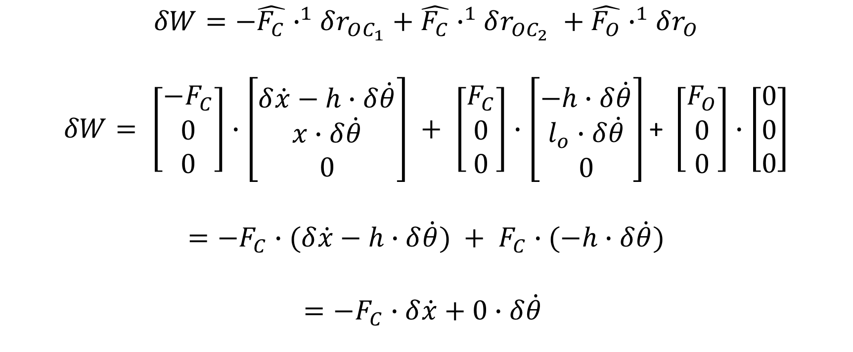
COLLISION MODELLING (VIRTUAL WORK DONE BY IMPULSE FORCES)
$$δW=−\hat{F_{C}}∙^{1}δr_{OC_{1}}+\hat{F_{C}}∙^{1}δr_{OC_{2}} +\hat{F_{O}}∙^{1}δr_{O}$$
$$δW= \left[\begin{matrix}{−F}_{C} \\ 0 \\ 0\end{matrix}\right]∙\left[\begin{matrix}δ\dot{x}−h∙δ\dot{θ} \\ x∙δ\dot{θ} \\ 0\end{matrix}\right] + \left[\begin{matrix}F_{C} \\ 0 \\ 0\end{matrix}\right]∙\left[\begin{matrix}−h∙δ\dot{θ} \\ l_{o}∙δ\dot{θ} \\ 0\end{matrix}\right]\text{+ }\left[\begin{matrix}F_{O} \\ 0 \\ 0\end{matrix}\right]∙\left[\begin{matrix}0 \\ 0 \\ 0\end{matrix}\right]$$
$$=−F_{C}∙(δ\dot{x}−h∙δ\dot{θ}) + F_{C}∙(−h∙δ\dot{θ})$$
$$={−F}_{C}∙δ\dot{x}+0∙δ\dot{θ}$$

Slide 22
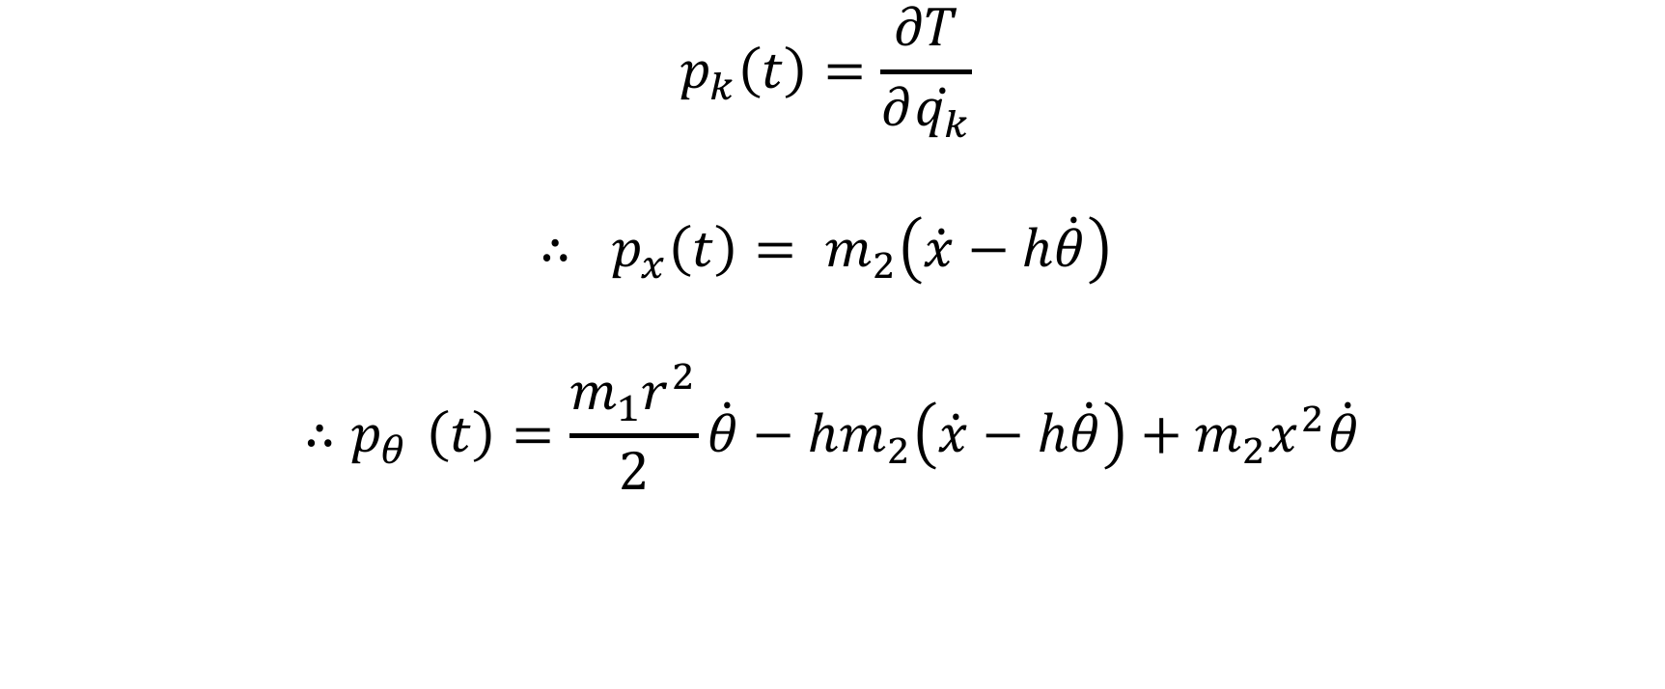
COLLISION MODELLING (GENERALIZED MOMENTA)
$$p_{k}\left(t\right)=\frac{∂T}{∂\dot{q_{k}}}$$
$$∴ p_{x}\left(t\right)= m_{2}\left(\dot{x}−h\dot{θ}\right)$$
$${∴p}_{θ}\left(t\right)=\frac{m_{1}r^{2}}{2}\dot{θ}−hm_{2}\left(\dot{x}−h\dot{θ}\right)+m_{2}x^{2}\dot{θ}$$

Slide 23
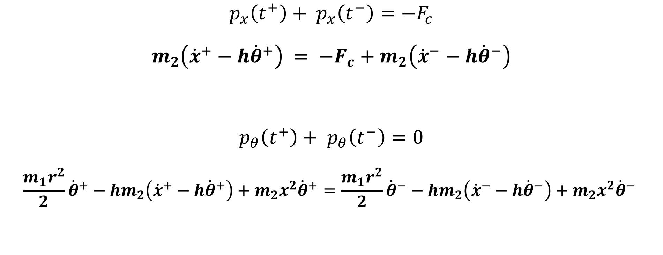
COLLISION MODELLING (CHANGE IN MOMENTA)
$$p_{x}\left(t^{+}\right)+ p_{x}\left(t^{−}\right)=−F_{c}$$
$$m_{2}\left({\dot{x}}^{+}−h{\dot{θ}}^{+}\right) = −F_{c}+m_{2}\left({\dot{x}}^{−}−h{\dot{θ}}^{−}\right)$$
$$p_{θ}\left(t^{+}\right)+ p_{θ}\left(t^{−}\right)=0$$
$$\frac{m_{1}r^{2}}{2}{\dot{θ}}^{+}−hm_{2}\left({\dot{x}}^{+}−h{\dot{θ}}^{+}\right)+m_{2}x^{2}{\dot{θ}}^{+}=\frac{m_{1}r^{2}}{2}{\dot{θ}}^{−}−hm_{2}\left({\dot{x}}^{−}−h{\dot{θ}}^{−}\right)+m_{2}x^{2}{\dot{θ}}^{−}$$
Equation 01
Equation 02

Slide 24
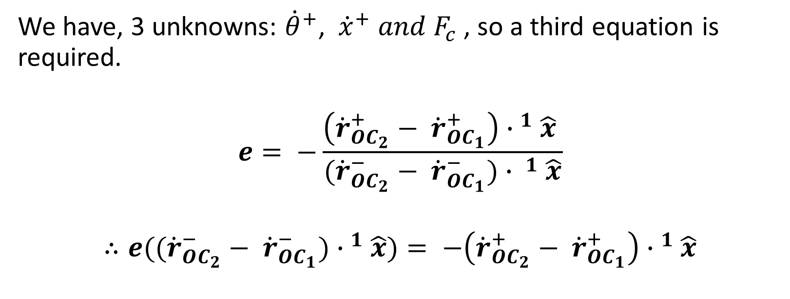
COLLISION MODELLING (THIRD EQUATION)
We have, 3 unknowns: ${\dot{θ}}^{+}$, ${\dot{x}}^{+} and F_{c}$, so a third equation is required.
$$e= −\frac{\left({\dot{r}}_{OC_{2}}^{+}− {\dot{r}}_{OC_{1}}^{+}\right){∙ }^{1}\hat{x} }{({\dot{r}}_{OC_{2}}^{−}− {\dot{r}}_{OC_{1}}^{−}){∙ }^{1}\hat{x}}$$
$$∴e(({\dot{r}}_{OC_{2}}^{−}− {\dot{r}}_{OC_{1}}^{−}){∙ }^{1}\hat{x})= −\left({\dot{r}}_{OC_{2}}^{+}− {\dot{r}}_{OC_{1}}^{+}\right){∙ }^{1}\hat{x}$$

Slide 25
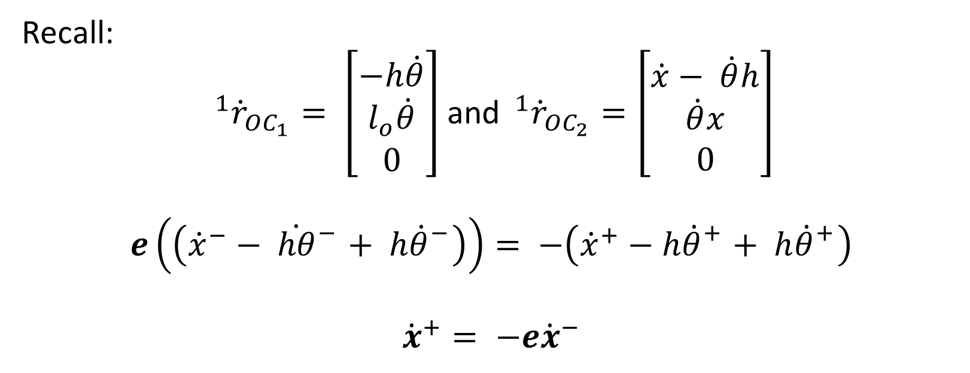
COLLISION MODELLING (THIRD EQUATION)
Recall:
$^{1}{\dot{r}}_{OC_{1}}= \left[\begin{matrix}−h\dot{θ} \\ l_{o}\dot{θ} \\ 0\end{matrix}\right]$and$^{1}{\dot{r}}_{OC_{2}}=\left[\begin{matrix}\dot{x}− \dot{θ}h \\ \dot{θ}x \\ 0\end{matrix}\right]$
$$e\left(\left({{\dot{x}}^{−}− \dot{hθ}}_{}^{−}+ {h\dot{θ}}_{}^{−}\right)\right)= −\left({{\dot{x}}^{+}−h\dot{θ}}_{}^{+}+ {h\dot{θ}}_{}^{+}\right)$$
$${\dot{x}}^{+}= −e{\dot{x}}^{−}$$
Equation 03

Slide 26
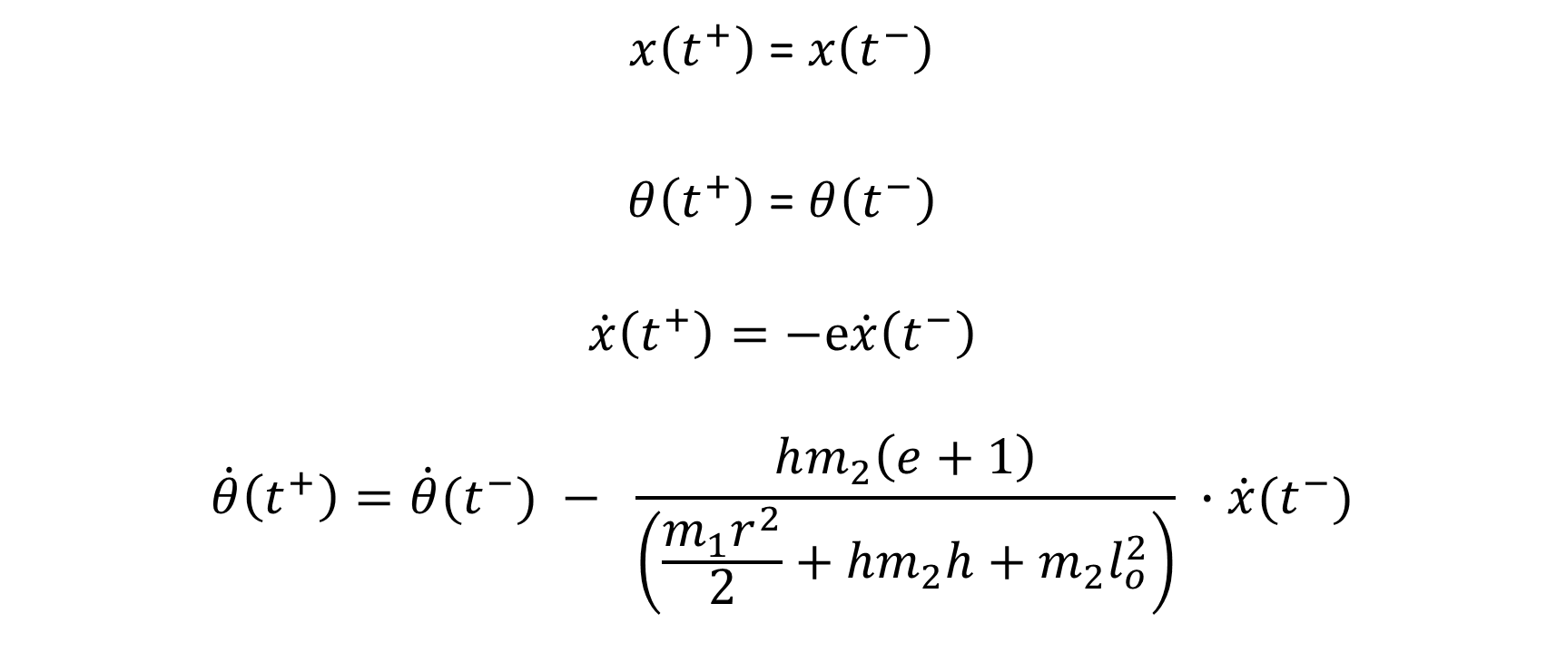
COLLISION MODELLING (FINAL EQUATIONS)
$x\left(t^{+}\right)$ = $x\left(t^{−}\right)$
$θ\left(t^{+}\right)$ = $θ\left(t^{−}\right)$
$$\dot{x}\left(t^{+}\right)=−e\dot{x}\left(t^{−}\right)$$
$$\dot{θ}\left(t^{+}\right)={\dot{θ}(t}^{−}) − \frac{hm_{2}\left(e+1\right)}{\left(\frac{m_{1}r^{2}}{2}+hm_{2}h+m_{2}l_{o}^{2}\right)} ∙{\dot{x}(t}^{−})$$

Slide 27
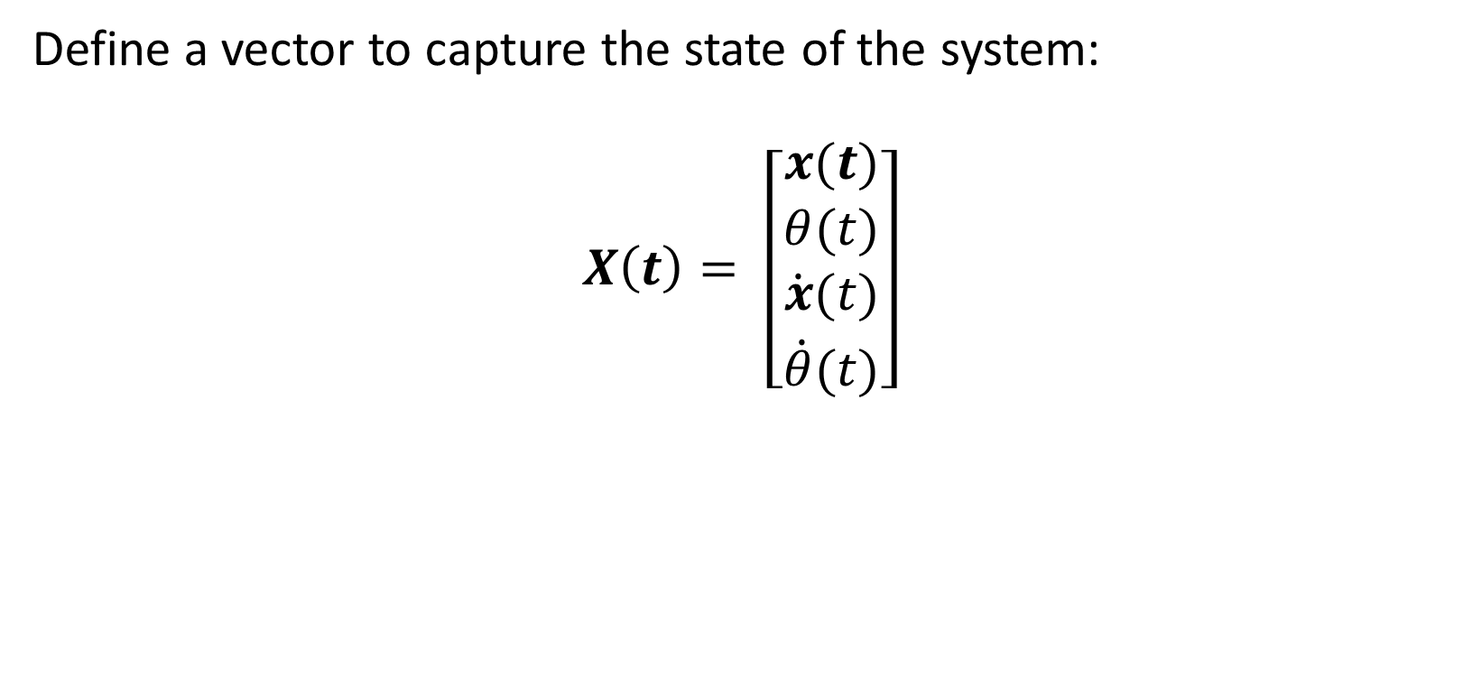
SIMULATION AND ANIMATION
Define a vector to capture the state of the system:
$$X\left(t\right)= \left[\begin{matrix}x(t) \\ \begin{aligned}θ(t) \\ \dot{x}(t) \\ \dot{θ}(t)\end{aligned}\end{matrix}\right]$$

Slide 28
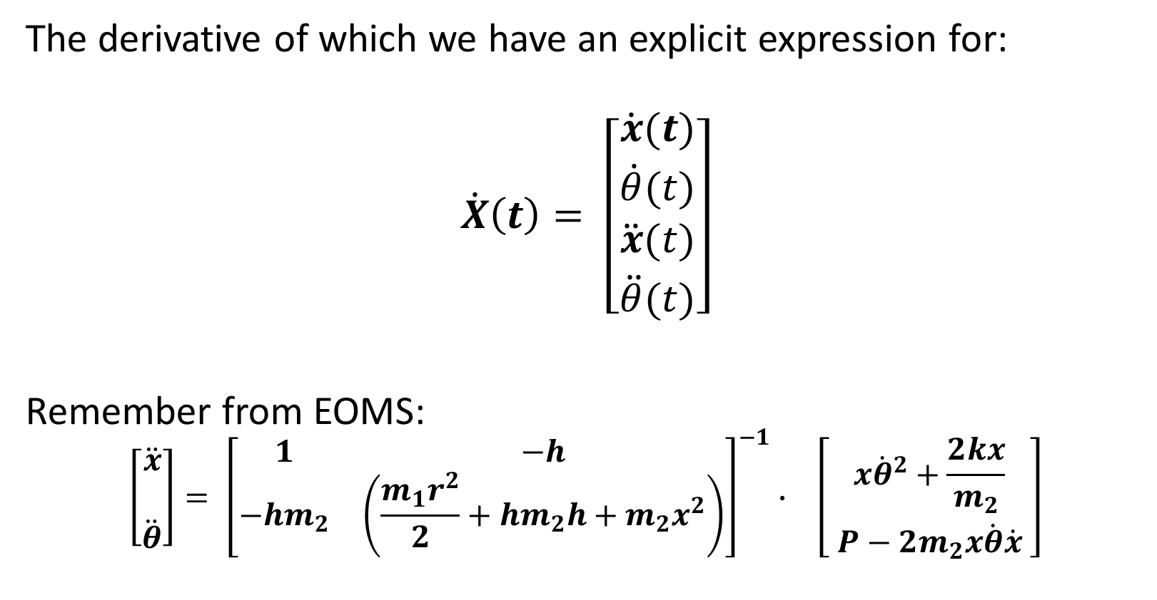
SIMULATION AND ANIMATION
The derivative of which we have an explicit expression for:
$$\dot{X}\left(t\right)= \left[\begin{matrix}\dot{x}(t) \\ \begin{aligned}\dot{θ}(t) \\ \ddot{x}(t) \\ \ddot{θ}(t)\end{aligned}\end{matrix}\right]$$
Remember from EOMS:
$$\left[\begin{matrix}\begin{aligned}\ddot{x} \\ \end{aligned} \\ \ddot{θ}\end{matrix}\right]= {\left[\begin{matrix}1 & −h \\ −hm_{2} & \left(\frac{m_{1}r^{2}}{2}+hm_{2}h+m_{2}x^{2}\right)\end{matrix}\right]}^{−1}∙ \left[\begin{matrix}x{\dot{θ}}^{2}+\frac{2kx}{m_{2}} \\ P−{2m}_{2}x\dot{θ}\dot{x} \end{matrix}\right]$$

Slide 29
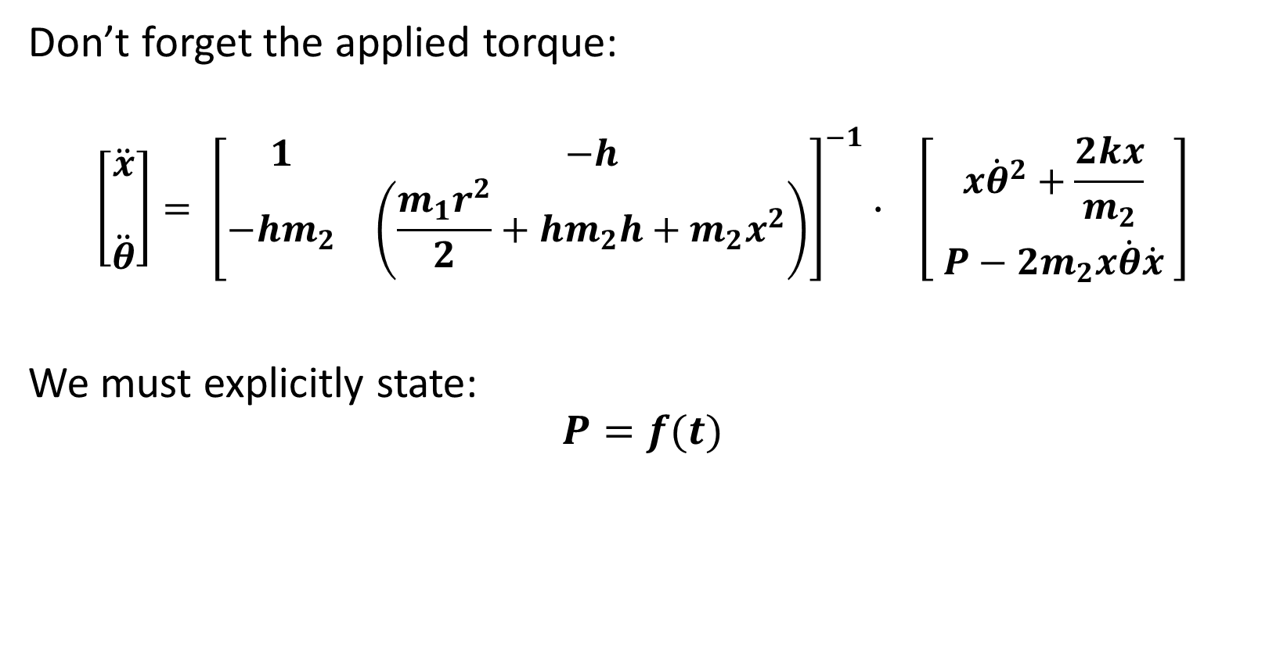
SIMULATION AND ANIMATION
Don’t forget the applied torque:
$$\left[\begin{matrix}\begin{aligned}\ddot{x} \\ \end{aligned} \\ \ddot{θ}\end{matrix}\right]= {\left[\begin{matrix}1 & −h \\ −hm_{2} & \left(\frac{m_{1}r^{2}}{2}+hm_{2}h+m_{2}x^{2}\right)\end{matrix}\right]}^{−1}∙ \left[\begin{matrix}x{\dot{θ}}^{2}+\frac{2kx}{m_{2}} \\ P−{2m}_{2}x\dot{θ}\dot{x} \end{matrix}\right]$$
We must explicitly state:
$$P=f(t)$$

Slide 30
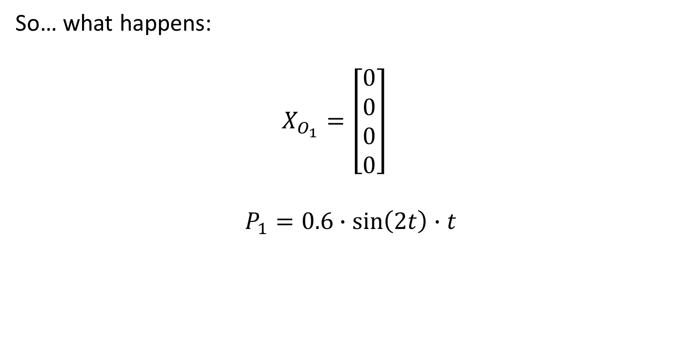
SIMULATION AND ANIMATION
So… what happens:
$$X_{O_{1}}=\left[\begin{aligned}0 \\ 0 \\ 0 \\ 0\end{aligned}\right]$$
$$P_{1}=0.6∙\sin\left(2t\right)∙t$$
Initial conditions
Torque applied

Slide 31
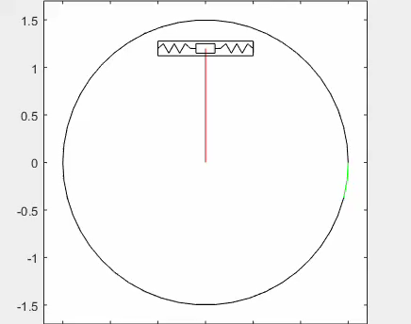
SIMULATION AND ANIMATION
Collisions

Slide 32
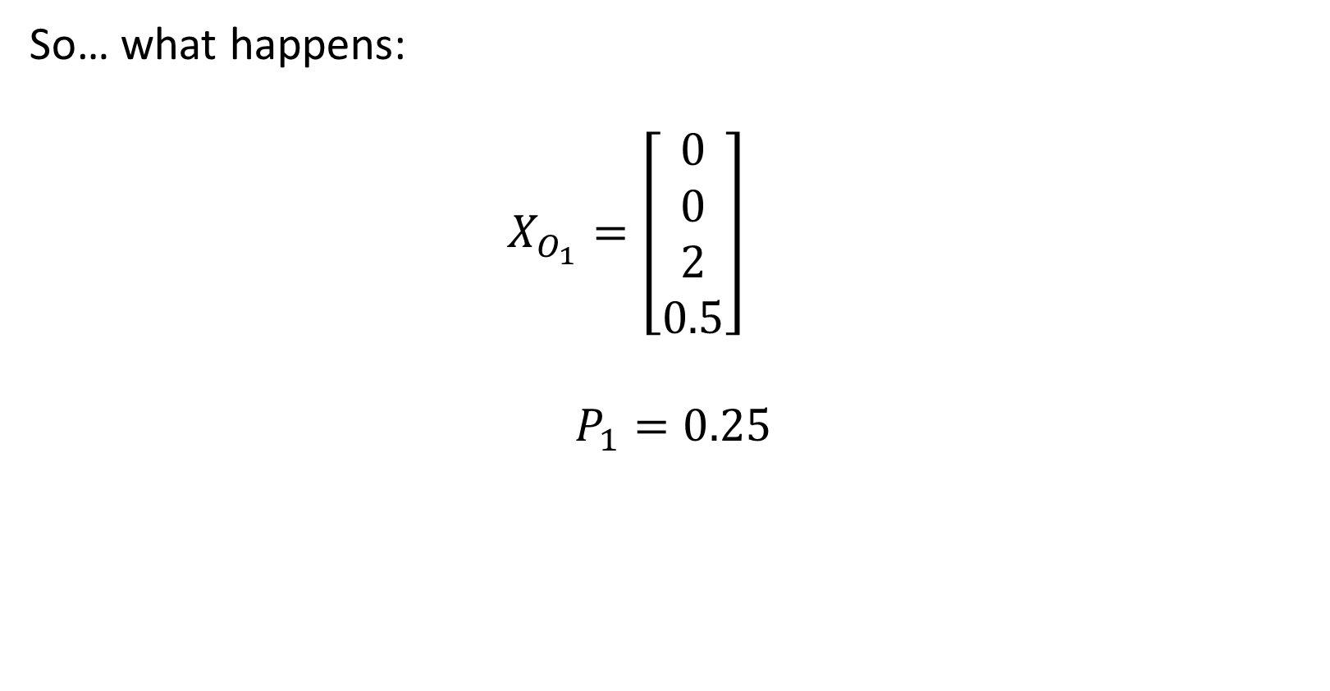
SIMULATION AND ANIMATION
So… what happens:
$$X_{O_{1}}=\left[\begin{aligned}0 \\ 0 \\ 2 \\ 0.5\end{aligned}\right]$$
$$P_{1}=0.25$$

Slide 33
SIMULATION AND ANIMATION
Collisions everywhere

